Slide 1


Towards commodity smarthomes
Ratul Mahajan

Slide 2


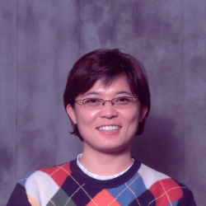



Partners in crime
A.J. Brush
Colin Dixon
Bongshin Lee
Sharad Agarwal
Frank Martinez
Stefan Saroiu

Slide 3

Smarthomes
Ability to automate and control multiple, disparate systems within the home [ABI Research]
Notes:
What are smarthomes?
Sensing and actuating devices all around, which combine to perform actions of interest to users with little or no effort.
ABI definition: disparate systems is key. all lightning is not smart; all computers is not smart.
<object width="640" height="360"><param name="movie" value="http://www.youtube-nocookie.com/v/qsDRV1UjySI?version=3&amp;hl=en_US&amp;rel=0"></param><param name="allowFullScreen“ value="true"></param><param name="allowscriptaccess" value="always"></param><embed src="http://www.youtube-nocookie.com/v/qsDRV1UjySI?version=3&amp;hl=en_US&amp;rel=0" type="application/x-shockwave-flash" width="640" height="360" allowscriptaccess="always" allowfullscreen="true"></embed></object>

Slide 4

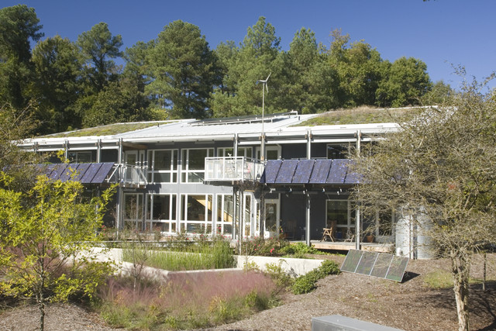
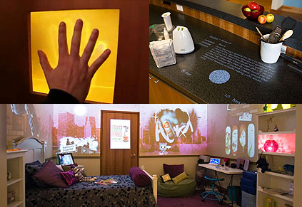
Status of smarthome technology
Envisioned by many researchers and companies
Struggling to break into the mainstream
Despite commercial availability since 1970s
Notes:
Pictures:
Duke smart house
Microsoft home of the future
Disney’s smart house

Slide 5
Talk outline
What explains the gap?
What really explains the gap?
How to bridge the gap?
Notes:
A study
A deeper, systemic explanation
A system, under development for 2 years. Design iterated upon based on our experience and a small community of users and developers.

Slide 6
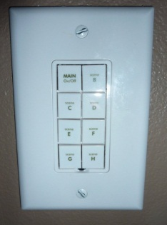
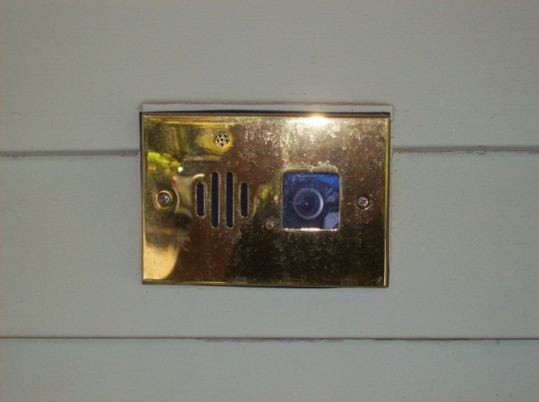
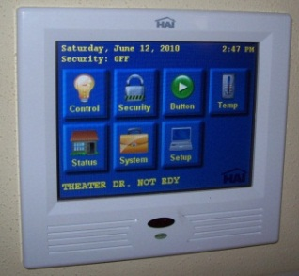
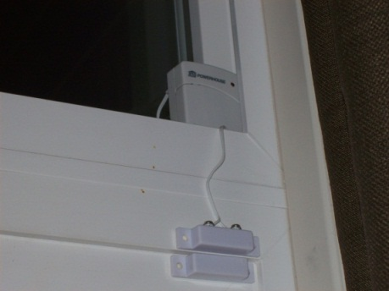
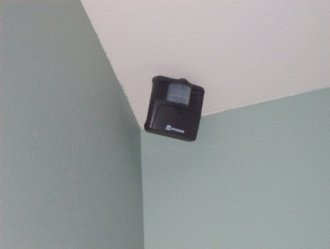




Study to understand the gap
Visited homes with modern automation systems
Interviewed 31 people across 14 homes
Inventory
Semi-Structured Interview
Questionnaire
Home Tour
[Home automation in the wild: Challenges and opportunities, CHI 2011]
Notes:
We wanted to understand the reasons behind this gap.
Pictures:
Remote lighting control
Security cameras
Multi-room audio/video systems
Motion detectors
Door sensor
People interviewed were both gurus and consumers

Slide 7
How smarthomes?
DIY (do-it-yourself)
Outsource
$200 - $60k
Median: $5k
$14k – $120k
Median: $40K
Notes:
Two categories of people.
- DIY: buy hardware and stitch things together themselves.
- OS: pay someone to bring in a complete system
What exactly the outsourcing community is paying for will become clear in a bit.

Slide 8
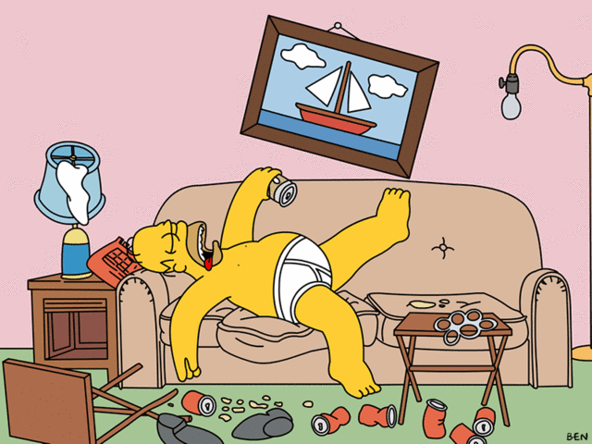
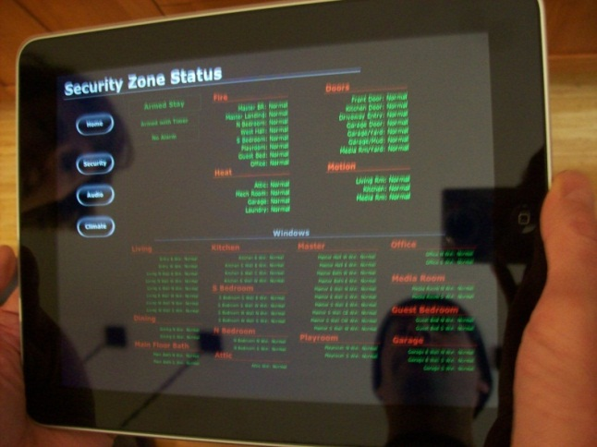
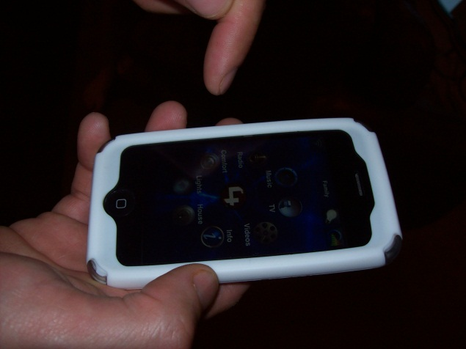
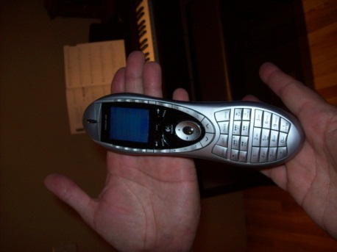
Why smarthomes?
Convenience | Peace of mind | Control
“It allows me to be lazy”
Notes:
If I had a penny for every time someone said a variant of “it allows me to be lazy,” I’ll have a quarter.
“It allows me to be lazy, honestly, because every day [before automation] I would go double check the locks, make sure all the lights are off on all the floors and make sure that everything’s closed.”
Peace of mind.
Status of locks and doors, including garage doors.
Centralized control and knowledge of what is happening at the house.
“I like just being in control, like during the day, I get an email every time somebody comes to the door.”

Slide 9
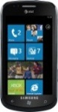
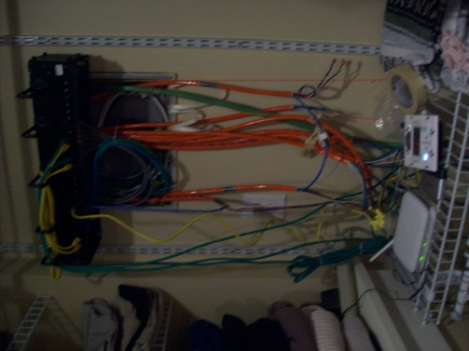



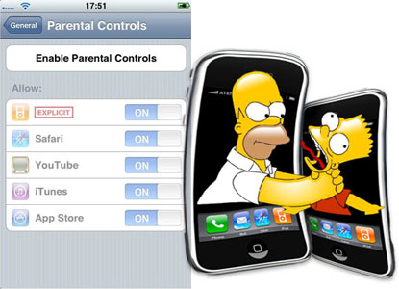
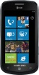

Why not smarthomes? Barriers to mainstream adoption
Hardware inflexibility | Poor extensibility | Management nightmare
Adding tasks
Access control
or
Adding devices
Notes:
More importantly, we also learned from these people why the smarthome technology is not ready for mainstream.
Hardware inflexibility: networking wires, low-voltage wiring
Extensibility includes making things work together.
Management includes security.
- Choice between security and inconvenience when it comes to guest access and remote access.
We focus on the last two problems: Device vendors are already taking care of the first one. Wireless is becoming commonplace, and low-voltage devices are moving to regular voltage.
Also, these problems are not unique to smarthomes or home automation systems. Studies show that these are general problems with lay users needing to control multiple devices.
- Internet of things
- Elder care
So, solutions to these problems will make home computing better in general, and not just smarthomes.

Slide 10
Talk outline
What explains the gap?
What really explains the gap?
How to bridge the gap?
Notes:
Now, lets step back and understand why these problems arise in the first place. Start with understanding the home computing environment and its characteristics.

Slide 11
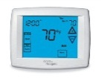
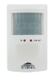
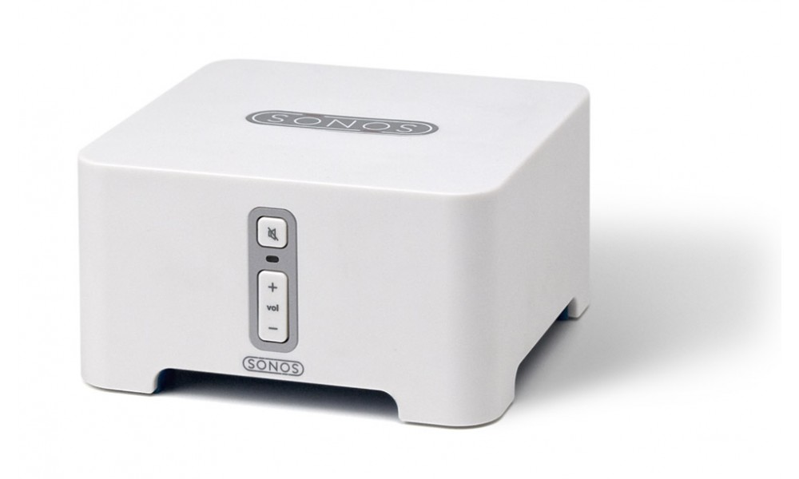
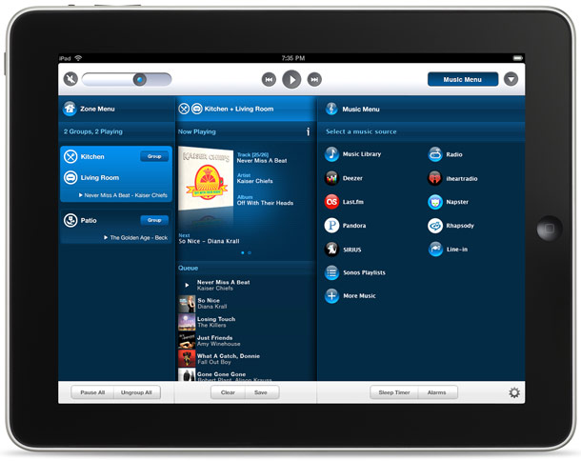


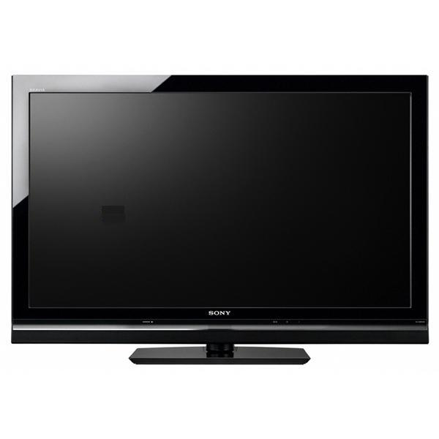
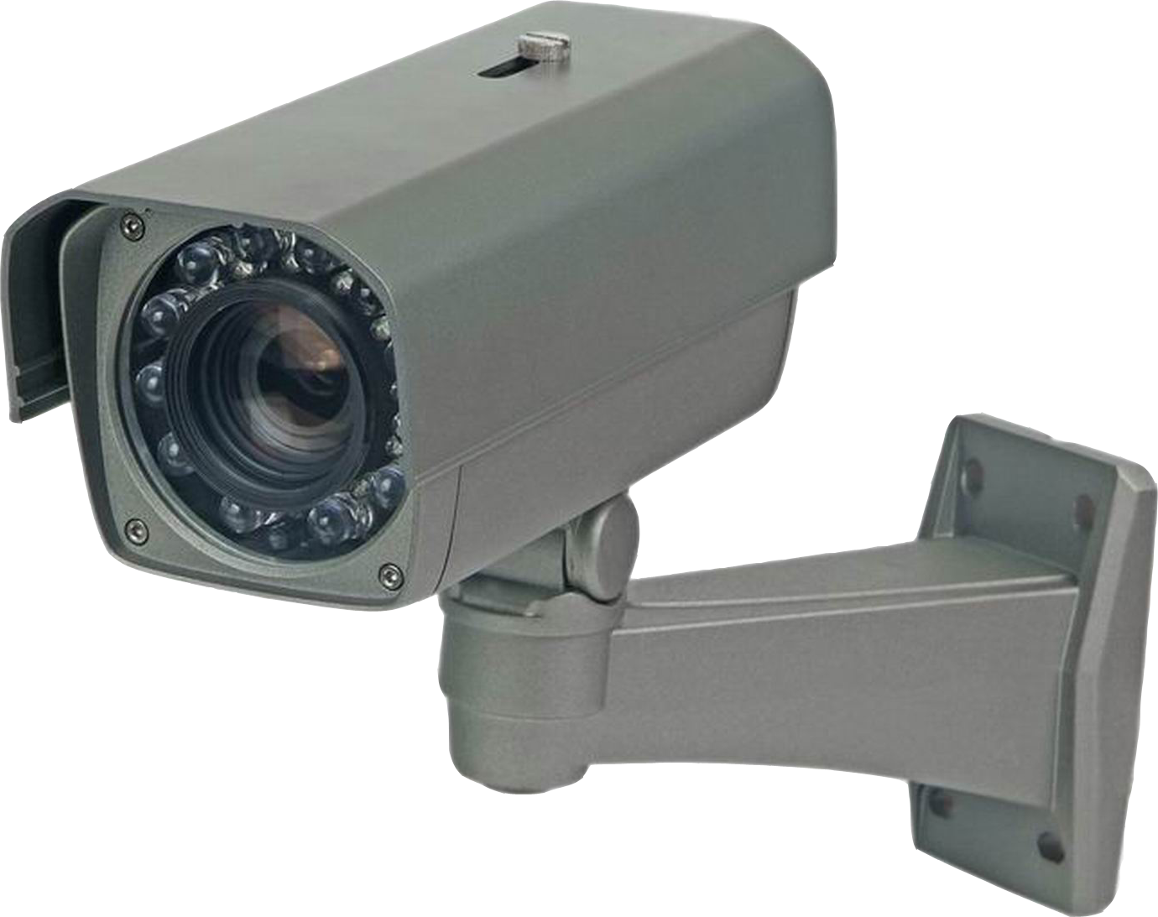
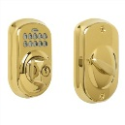
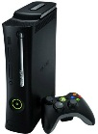
The home computing environment
Energy monitoring
Video recording
Climate
control
Keyless entry
Remote lock
Tasks (software)
Devices (hardware)
Notes:
Here is how I look at the home computing environment: hardware, and things people want to do with this hardware.
You could potentially describe all computing environments as having software and hardware. What sets the home environment apart is the nature of the hardware devices and software tasks, combined with two other factors.

Slide 12
Key characteristics of the environment
Users are not technically savvy
Extreme heterogeneity across homes
Tasks
Devices
Topology
Control, coordination
Control | Media | Security | Environment
Notes:
Even if the users are savvy, they couldn’t be bothered, that is, they are uninterested.
Desired tasks: There are many tasks that are of interest to only a small set of people. No killer app.
Devices: your TV is a different brand than mine, your camera is different from mine, etc. brands aside, different devices can speak different protocols. light switches may use Z-Wave, ZigBee or X10; and TVs use DLNA, UPnP A/V and/or other custom protocols.
Topology: we interconnect our devices in different ways. Some homes have WiFi only networks, some have a mix of wired and wireless. additionally, some devices such as smartphones could connect using 3g as well.
Control, coordination:
Different homes have different requirements as to how various activities should occur. E.g., some want the Xbox to not run after 9 PM, and some want the security camera to record only at night.
If multiple tasks are running, cases where they access a device at the same time will inevitably arise. Such accesses may be undesirable. For instance, a climate control application may want the window open when a security application wants it closed.

Slide 13
Prevalent abstractions for organizing home technology
Network of devices
=> Interoperability protocols
DLNA, Z-Wave, Speakeasy, …..
Closed, complete systems
=> Vertical integration
Crestron, Control4, EasyLiving, …
Remote monitoring
Climate control
Notes:
containing heterogeneity and complexity requires the right abstractions. So, what are the main abstractions around which home technology is organized today? There are two.
The first abstraction is a network of devices. This viewpoint leads one to develop protocols by which devices can talk to each other, that is, interoperability protocols. It does not worry so much about how tasks are implemented on top of this network.
The second abstraction views technology as complete, closed systems. This viewpoint leads to software that is coupled directly with the hardware and works only with the specific hardware, that is, there vertical integration.
Both of these abstractions are promoted by both industry as well as research communities.
But I’ll argue in next couple of the slides that they are both problematic in the home setting.

Slide 14
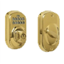
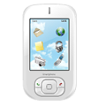


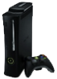
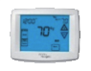
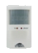

Interop alone leaves too much for users
Video Recording
Climate
Control
Camera-Based Entry
Remote Lock
No systematic manner to add tasks
Does not handle management and security
Notes:
People bring in solutions developed for the enterprise contexts
This is the abstraction that DIY-ers are working with.

Slide 15


Vertical integration limits extensibility
Energy monitoring
Video recording
Climate
control
Keyless entry
Remote lock
Keyless entry
Climate
control
Video recording
Storage, printing
Notes:
This is the abstraction that outsourcers are working with

Slide 16
Talk outline
What explains the gap?
What really explains the gap?
How to bridge the gap?

Slide 17
Our abstraction
View the home as a computer
Networked devices =~ peripherals
Tasks over these devices =~ applications
Adding devices =~ adding a peripheral
Adding tasks =~ installing an application
Managing networked devices =~ managing files
[The home needs an operating system (and an app store), HotNets 2010]
Notes:
A different paradigm for organizing technology in the home

Slide 18


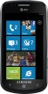


HomeOS: An OS for the home
HomeStore
Video Rec.
Remote Unlock
Climate
HomeOS
Z-Wave, DLNA, WiFi, etc.
HomeOS logically centralizes all devices
Users interact with HomeOS, not individual devices
HomeStore helps find compatible devices and apps
Notes:
HomeOS is our attempt at implementing the computer abstraction
HomeOS logically centralizes all technology in the home.
Users interact with HomeOS rather than individual devices, which makes them easy to manage.
HomeOS provides applications simple APIs to access these devices.
Cross-device functionality is implemented by applications, not users.
HomeStore simplifies the tasks of finding compatible devices and applications.
This is doable today because:
- most devices are network controllable
- technology around remote control of devices is maturing, for example, through standards such as DLNA, Z-Wave, and ZigBee.

Slide 19
Goals of HomeOS
Easy to manage and secure by non-experts
Simplified application development
Rapid inclusion of new devices and features
Mgmt. primitives align with users’ mental models
APIs are protocol-independent services
Kernel is agnostic of device functionalities

Slide 20
HomeOS layering model
Application layer
Management layer
Device functionality layer
Device connectivity layer
Tasks
Control, coordination
Device
Topological
Heterogeneity source handled
Notes:
Layering is the way to contain complexity

Slide 21
DCL and DFL
DCL provides basic connectivity to devices
DFL exports device functionality as a service
Services are protocol-independent
Identified using roles and operations
DFL
DCL
Dimmer | MediaRenderer | PTZ Camera
Set(level) Get*() → level | Play(uri) PlayAt(uri, time) Stop() Status*() → uri, time | GetImage*() → bitmap Up(), Down() Left(), Right() ZoomIn(), ZoomOut()
Notes:
DCL includes discovery and pairing
One DCL module per device protocol

Slide 22
DCL and DFL: Reflections
Device interaction is split across two layers
Allows smaller modules, avoids functionality duplication
Functional specs are more stable than device protocols
Allows independent evolution of protocols and apps
DFL modules can export multiple roles for a device
Allows easy extensibility along with backward compatibility

Slide 23


Management layer: Requirements
Time-based access control
Apps as security principals
Easy-to-understand settings
Notes:
The management layer of HomeOS provides a central place for users to manage the technology in their home and how applications are allowed to access it.
A major imperative in the design of this layer for us was it be configurable by non-technical users.
- Research shows that this requires primitives that are well-aligned with how users want to manage and control technology. Interfaces slapped on after the fact are not as effective. Instead, the design itself should reflect users’ mental models.
We uncover these mental models in interviews of the same set of participants that I mentioned earlier.
- We told them about a HomeOS-like system and asked them how they would like to control and manage it.
I summarize what we learned.
- Of particular note is how the requirements primitives differ from those in current PC OSes.
Time-based access control: parental controls and guest-access
Apps as security principals:
Easy to understand settings:
- wanted a way to verify their security settings so that they could convince themselves that they had correctly configured
their settings. Users asked for interfaces that would make it easy to answer questions about how they had or had not
configured things. For instance, whether guests can access security devices or whether a given application can
unlock the door after 10 PM. Providing reliable answers to such questions is difficult in current OSes due to complex primitives such as dynamic delegation [9].
Extra-sensitive devices:

Slide 24
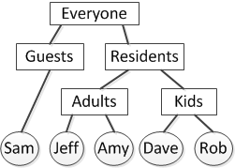

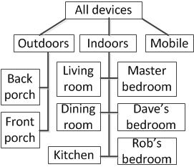
Management layer: Primitives
Access control policy as Datalog rules
Time-based user accounts
Hierarchical user, device groups
[device, user group, app, t_{start}, t_{end}, dayOfWeek, priority, accessMode]
Notes:
The requirements for security and access control are in conflict.
- Time-based access control and applications as security principals call for primitives that are richer than those in current OSes. However, non-experts find it hard to configure and understand even those primitives.
We reconcile the conflict by leveraging the fact that the home is a much simpler environment that does not need much of the complexity that is motivated by enterprise environments such as dynamic delegation and highly-customizable ACLs.
Explain the rule format.
Such rules meets our requirements. Users can configure time-based policies as well as restrict an application to specific devices. They can also easily understand their configuration by getting inverse views such as “which applications can access the door?”, “which devices can be accessed after 10 PM?” or “can a user ever access the back
door lock?” to fully understand their risk. Reliably providing such views is straightforward and fast because they can be
formulated as Datalog queries.
User and device groups: trees vs. sets

Slide 25
Application layer
Apps consume and compose DFL services
Manifests help with testing compatibility
Lists of mandatory and optional requirements
E.g., mandatory: {TV, SonyTV}, {MediaServer} optional: {Speaker}
Notes:
The application layer is where developer-written code runs to use and compose the devices in the home.
Consume DFL services using capabilities.
The key feature that HomeOS provides at app layer is the ability to ascertain if an application is compatible with the home.
- Today, when users bring software home, they have little assurance that it will work in their environment.
HomeOS applications provide a manifest describing what services they need to function.
- Helps check compatibility.
- If not compatible, HomeOS can also determine what additional devices are needed.
Explain manifests.
Our current manifest descriptions cannot encode complex requirements (e.g., two devices in the same room).
- They handle what we deem as the common case.
- Can extend later if needed

Slide 26
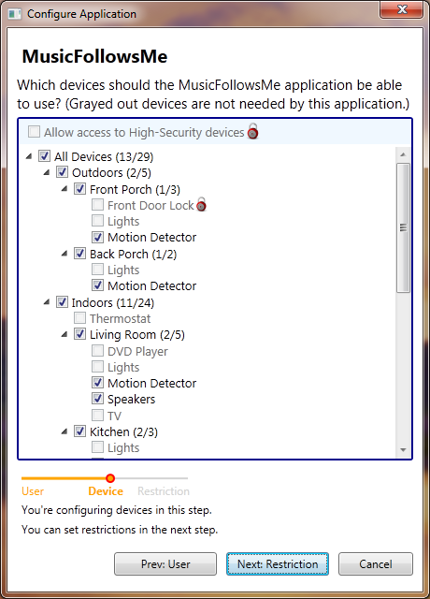
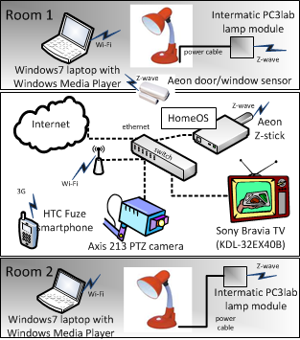
Implementation overview
Component-based OS
Uses C# and .NET
Notes:
Lightweight isolation

Slide 27
Evaluating HomeOS
Key questions:
Can non-technical users manage HomeOS?
Can developers easily write apps and drivers?
Method:
Field experiences
Controlled experiments

Slide 28
Field experience with HomeOS
12 homes running HomeOS for 4-8 months
Using different devices and applications
E.g., Cameras, light controllers, door-window sensors
41 student developers across 10 research groups
Developed new drivers and apps
E.g., energy meters, IM, appliance controllers
Notes:
Only 2 homes had prior experience with home automation

Slide 29
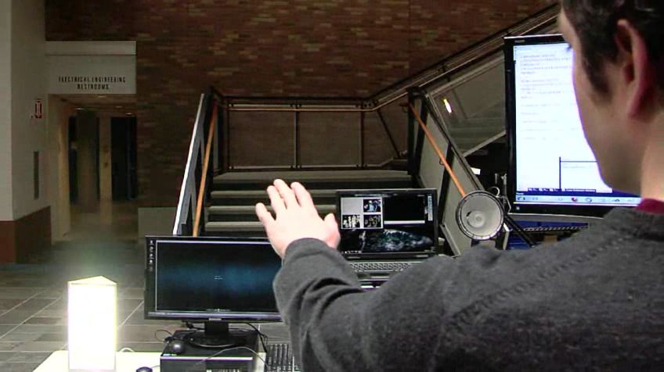
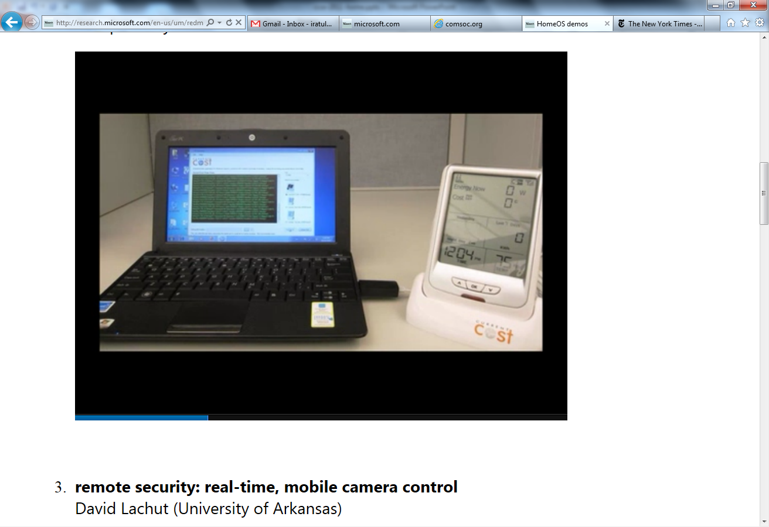
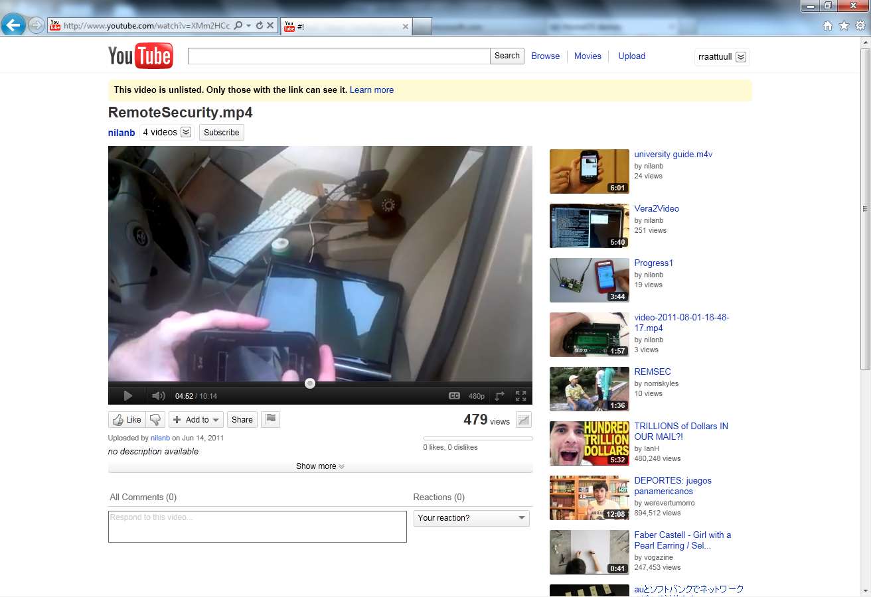
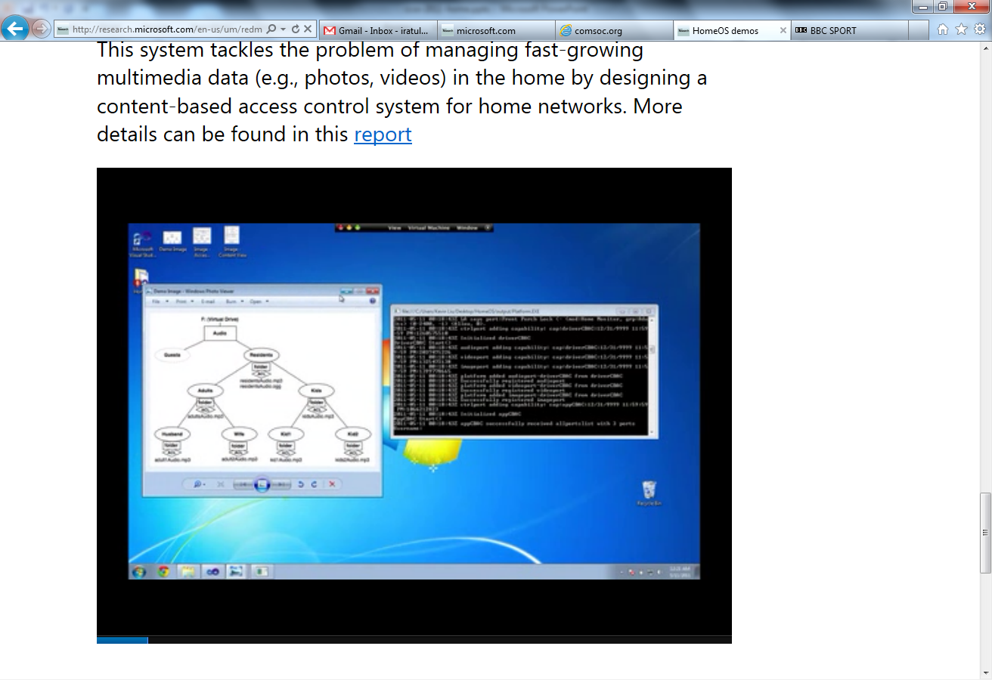
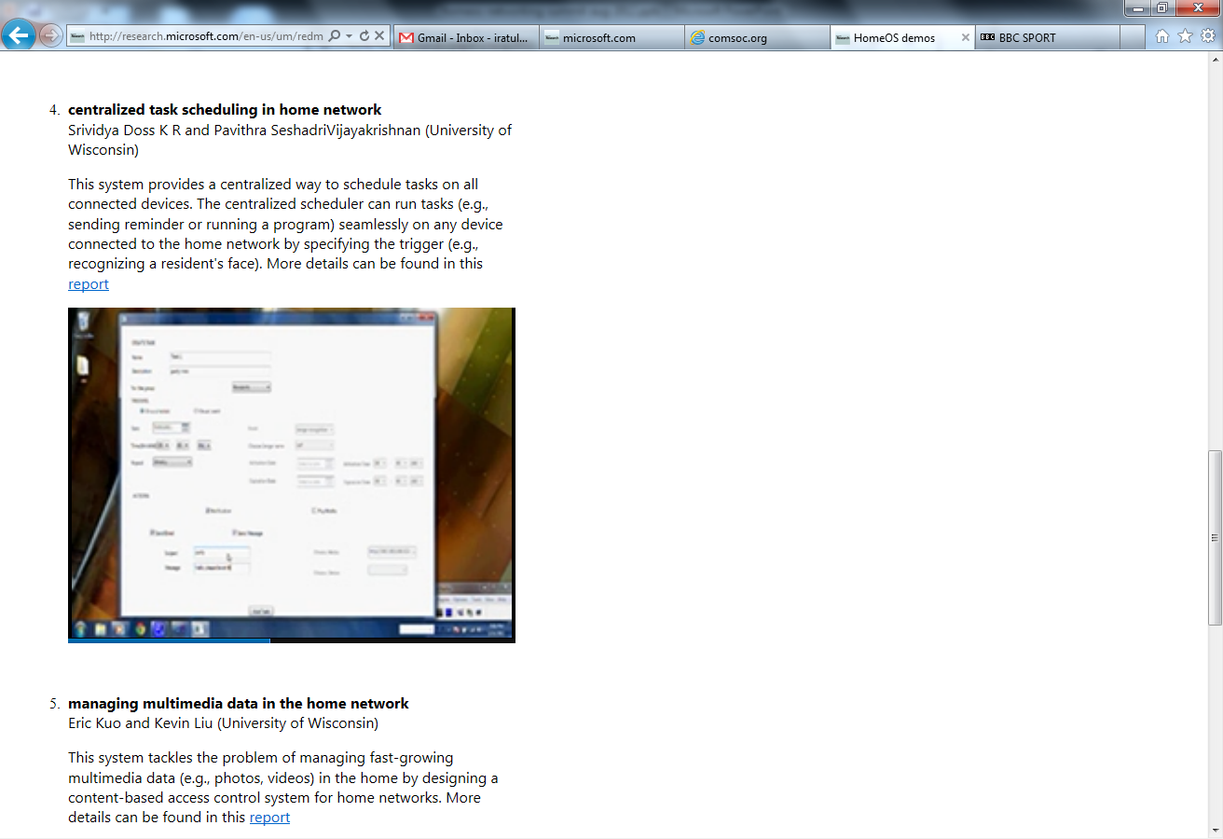
Example applications
For videos, see http://research.microsoft.com/homeos/

Slide 30
Field experience: The good
Users could manage their HomeOS deployments
Users particularly liked the ability to organically extend their technology
Developers found the programming abstractions and layering to be “natural”
Notes:
Users could manage: We did not provide any support beyond basic documentation
Organic growth: Give Frank’s example.
Developers: DCL-DFL split emerged later in Arkansas case

Slide 31
Field experience: The bad
Users found it hard to diagnose faults
Interoperability protocols can be fragile
Not all device features may be exposed over the network
Notes:
Interoperability protocols reveal limited information
Diagnosability: even ICMP would be great
Particularly hurts in the face of decentralized data plane
Fragility: DLNA was the culprit; need transcoding
Device features: set top boxes
Hinders rich application development

Slide 32
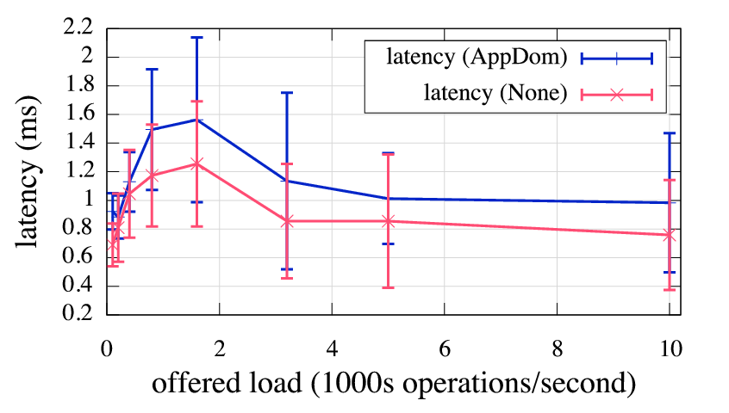
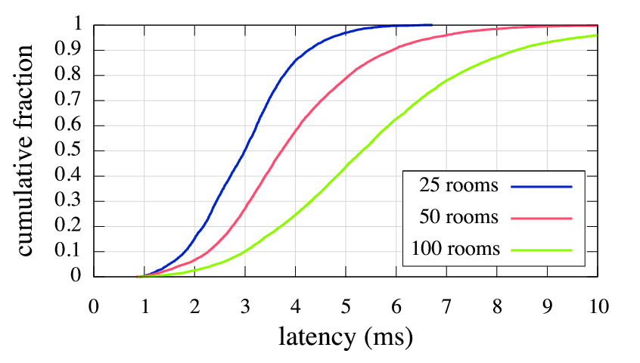
Results from controlled studies
10 developers asked to write a realistic app
8 finished in under 2 hours
12 non-technical users given 7 mgmt. tasks w/o training
77% completion rate; 89% after removing an outlier task
System can support interactive apps and large homes

Slide 33
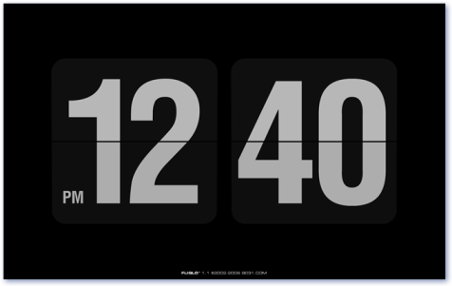

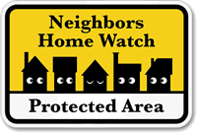
Ongoing work
Predictable control through fast forwarding
Sensor data privacy and neighborhood watch
Notes:
Second-order problems
Fast forwarding: Radio alarm clock
Concrete context for studying sensor data privacy

Slide 34
Conclusions
Extensibility and management hurdles are keeping smarthomes out of mainstream
Organize home technology as a computer
HomeOS is one way to realize this organization
Notes:
Not just about smarthomes: home networks, elder care, internet of things, etc.
Pick the right abstraction; it matters.

